Slide 1
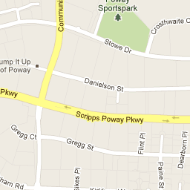
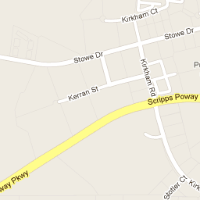
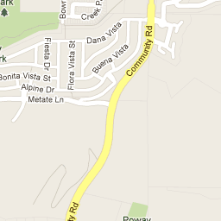
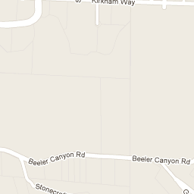
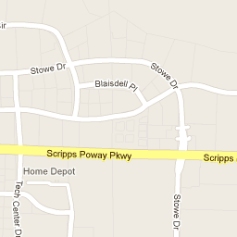
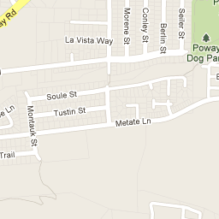
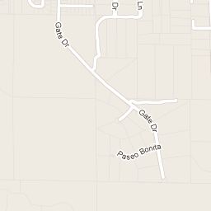
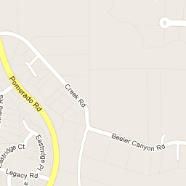
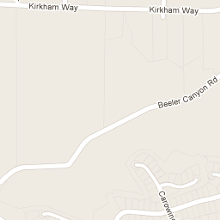
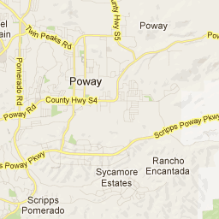

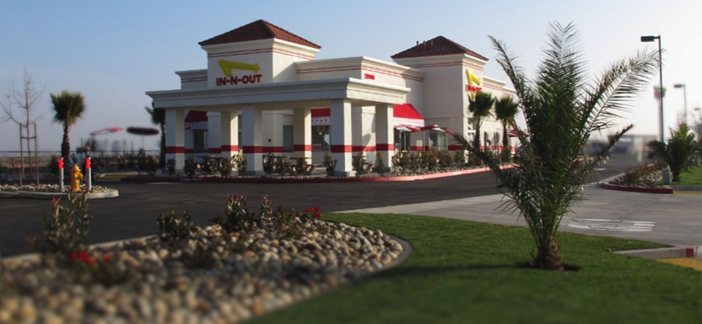

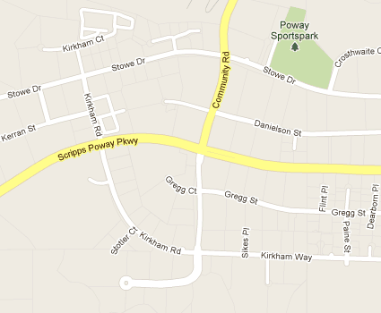
Reminder
Poway Cruisers Car Show
In-N-Out Burger
Saturday 4 November 2023
12890 Gregg Court Poway, CA
Corner of Scripps Poway Parkway & Community Road
in the east central part of the Kohl’s & Staples parking lot. Show is Free
First Saturday of Each Month
Show time: 11:00 AM – 2:00 PM
Favorites of Show Trophies and 50/50 Raffle at 2:00 PM
Contact Sean Hodgetts, Show Coordinator
(858)-774-4346 for more information
In-N-Out Burger website: www.in-n-out.com

