Slide 1
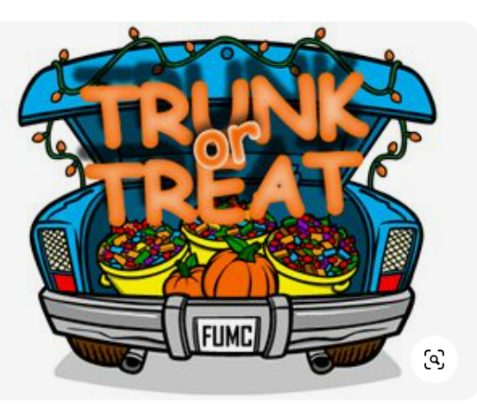


Poway Cruisers
Trunk or Treat
Poway Lowes Parking Lot
Southwest Corner
5:00 - 7:00 PM
Friday 30 October 2026
Organizer Bonnie Badders
bonniebadders@gmail.com

